Slide 1
You Want Change?
Here’s How to Make Change Stick!
Bill Silverman • Bill@SpringboardBizCoaching.com • 856-751-1989
Notes:
Center
Energy up, Voice up
Recording on
---------------------------------------------------------------- Hi everyone and welcome to
Next slide
Time:______________

Slide 2
Notes:
Owner Poll
I want to find out how many of you have gotten good ideas or found new services at landscapes that you want to implement when you get back home
Everyone Stand up:
Now sit down if You’ve picked up 0 or 1 idea 2, 3, 4, 5 or more
Share.
What’s one idea that you’re taking away

Slide 3
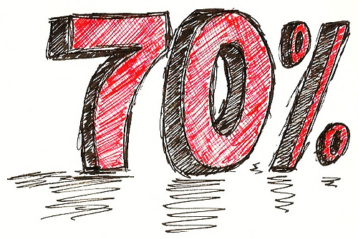
Notes:
In fact, research shows that 70% (and up to 80% in some studies) of organizational change efforts fail! 70 – 80%!
It may be implementing something simple or something
but most changes don’t stick!
Succeeding 3 out of every 10 times may be great if you’re hitting a baseball, but it’s not great for your company.

Slide 4
Notes:
the result is wasted time, wasted money and missed opportunities….
not to mention the stress and frustration
Bigger the business the bigger the challenges to making lasting change, grow too!
Show of hands:
Owners? Owners over $1M? $3M?
The same is true for the size of the change effort:
big business making big org changes you have the biggest challenge
And that’s the kind of work I do with my clients→

Slide 5
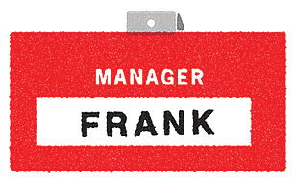
When you were smaller your success depended on your ability to do everything
I DO EVERYTHING
WORKER
SALESMAN
FRANK
FRANK
FRANK
MANAGER
ACCOUNTANT
MARKETING
FRANK
FRANK
FRANK
ADMIN
GOFER
OWNER
FRANK
FRANK
FRANK
Notes:
When you were a startup or a small company,
your success depended on your ability to do everything.
Above 1 million dollars, there are so many moving parts,
it’s hard to do an effective job of managing and doing it all.
Yet most owners don’t adjust to these new realities and challenges CLICK
You become the bottleneck in the business

Slide 6
Success above $1M depends on you running your business through your team get you there!
Frank
Operations
Sales
Office
Marketing
Frank
Frank
Frank
Frank
Notes:
What the Owners of successful million dollar and larger landscaping business do
is break their business down into chunks and assign managers to take responsibility for running different parts of their businesses.
NEXT SLIDE

Slide 7
Success above $1M depends on you running your business through your team get you there!
Frank
Operations
Sales
Office
Marketing
Andy
Zak
Roberto
Joan
Notes:
Then they manage the managers just like the CEO’s of major businesses do.
I help my clients restructure their businesses, build their management team and help them to take ownership for their functions, learn new management skills to run their businesses through their team just like the CEO of a major corporation does.
When they’re no longer the bottleneck their businesses the result is a growing, profitable business that can thrive without them.
And all of this is about successfully implementing change.
And what I’ve learned from my experiences is what we’re going to talk about today.
So, today we’re going answer 2 critical questions about making changes in your business.

Slide 8
Why?
Notes:
The first is WHY.
Why is it so difficult to make business building changes stick?
I’m going to share the 2 most important reasons why I think that change efforts fail

Slide 9
What?
Notes:
the second question I’m going to answer is what can you do to increase your success rate in making changes stick to well over the typical 30%
SEED
In this part of our session today, I’m going to share best practices for making change stick that I use with my clients to help them create better business results with less stress and frustration.

Slide 10
2 Reasons Why Change Efforts Fail
Notes:
ENERGY Up!
I want to start by discussing the 2 most important reasons that change efforts fail.
There are lots of reasons listed in books and articles on change, but these are my personal top 2
Knowing these 2 reasons, will help you in make the changes stick more effectively.

Slide 11
1. We underestimate the effort required to make change stick
Notes:
1
Many owners act as if they believe that announcing the change is the same as implementing it.
Like giving an order in the military they expect it to be carried out.
2
I think of this as the light switch model of change.
When you turn a light on, it goes on, and when you turn the light off it goes off.
many owners think that change works the same way.
3 But change doesn’t really work that way.

Slide 12
Notes:
1
It is true when you introduce changes in your business, the introduction can be pretty quick.
Like when you turn the lite off at night… CLICK
But you’re left standing in a dark room
and it takes a while for your eyes to adjust. CLICK
2
and a similar adjustment period happens when you introduce change in your business.
Change triggers an adjustment process in those employees who are expected to carry out the change.
And this adjustment process takes time & support
3
And this brings us to the 2nd major reason why I think so many change efforts fail…NEXT SLIDE

Slide 13
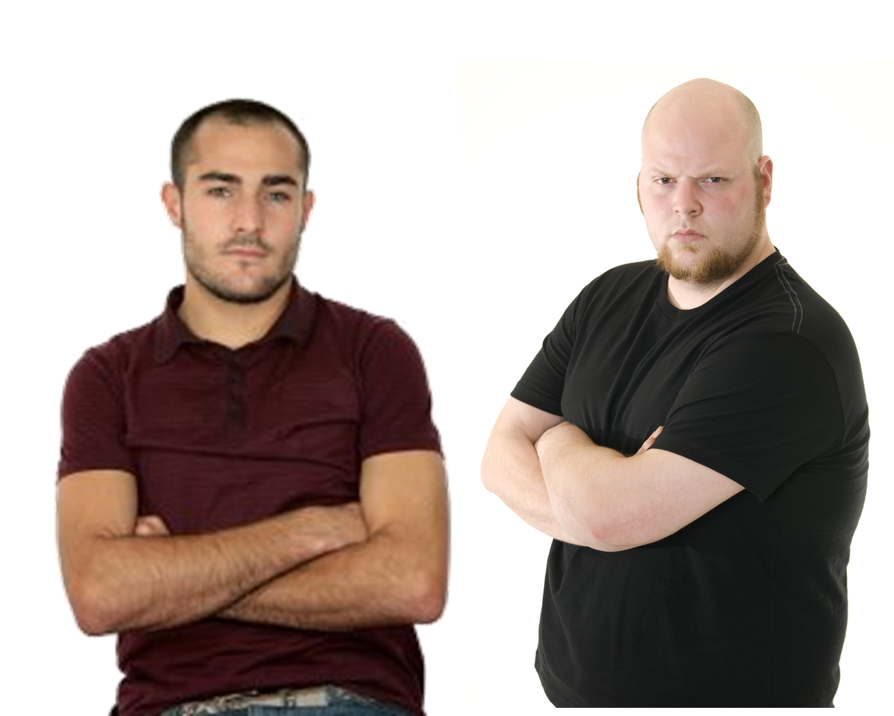
2. We don’t adequately take resistance to change into account
Notes:
Change requires your team to act or think in ways that they’ve never done before.
Because of this, there’s often a lot of resistance to it. And most of the time we don’t do a good enough job of managing this resistance

Slide 14
Let’s face it, change feels threatening…
Notes:
Let’s face it, change can be threatening.
Your excited- While you’re introducing that great new procedure or program,
your employees are concerned about how the change will impact them personally. They’re thinking :
What is wrong with the way things are now?
I’m going to need to learn new skills to do this. What if I fail?
Well there’s another thing on my plate.
So, it’s natural for change to be met with anxiety and resistance.

Slide 15
“Flavor of the month management” may have trained them to resist
Notes:
And you may have actually trained them to resist.
If you’re an owner that is constantly introducing new changes …
…but after the excitement’s worn off you don’t follow through you’re guilty of what I call “Flavor of the Month Management.”
You know who you are…
And your employees are on to you.
So they just wait you out, until the thrill is gone and you’re on to something new.

Slide 16
The success of your change efforts can be summed up in this change formula…
Power of your Change Efforts
- Resistance
= Change
Notes:
So I want to conclude this section by summing up what we talked about into a simple change formula:
CLICK the strength of your change efforts
CLICK minus the resistance you experience
CLICK equals the change you will achieve

Slide 17
Resistance
Notes:
So if your change efforts are small because you believe in the light switch model of change or maybe you just underestimated the amount of effort it would take
and the resistance you face is large, then not much change is going to happen.

Slide 18
Change Efforts
Notes:
If your change efforts are strong
and resistance is small or you are able to reduce resistance during the change process, CLICK then you will make change.
TIME: 1:50
So what I want to do now is share… NEXT SLIDE

Slide 19
Increase the Power of Your Change Efforts
Horsepower Killer #2

Slide 20
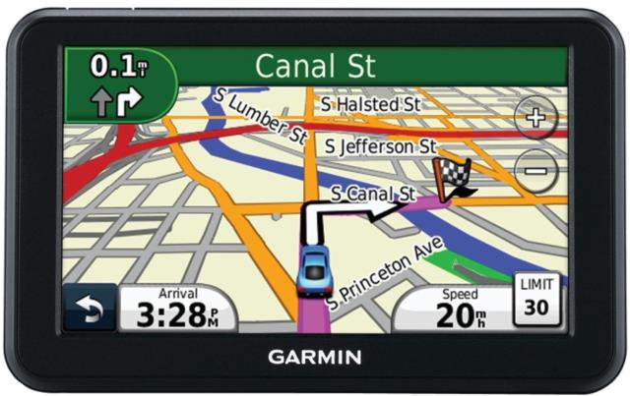
Notes:
1 How many of you use GPS?
2 Well, I have a confession to make… I have a GPS fetish…
3 Why I love my GPS
My kids say I can’t even make it to the bathroom with out my GPS
4 I think that GPS is the perfect model for strengthening your change efforts NEXT

Slide 21
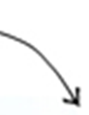
Powerful Change

Slide 22
This year I want you all to work hard on improving our profitability!
Notes:
Give example:
What typically happens: Build # 1. Owner makes a declaration and that’s it.
At the end of the year, nothing happened.
What needs to happen: Next Slide

Slide 23
1. Set clear goals

Slide 24
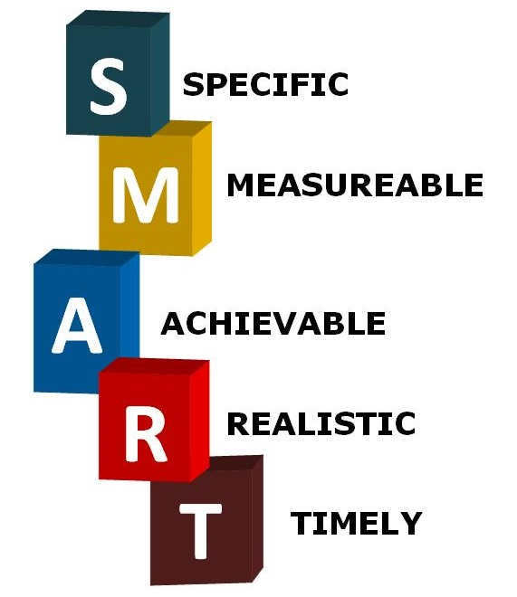
Use smart goals
BASED

Slide 25
What should I say?
Notes:
What should he say?

Slide 26
“I want increase net profit from 6% to 10% by year end 2019”

Slide 27
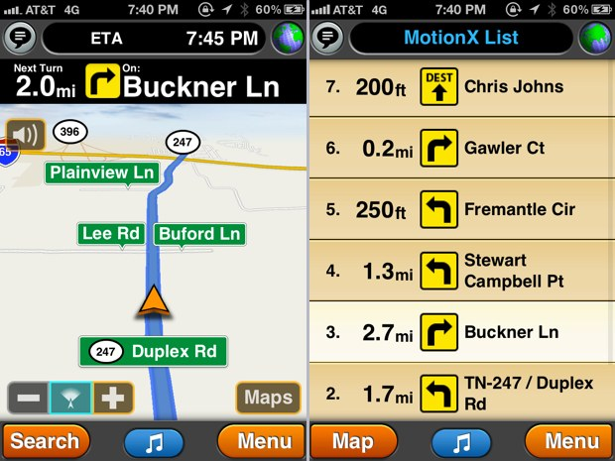
2. Create a step-by-step action plan that links actions to results

Slide 28
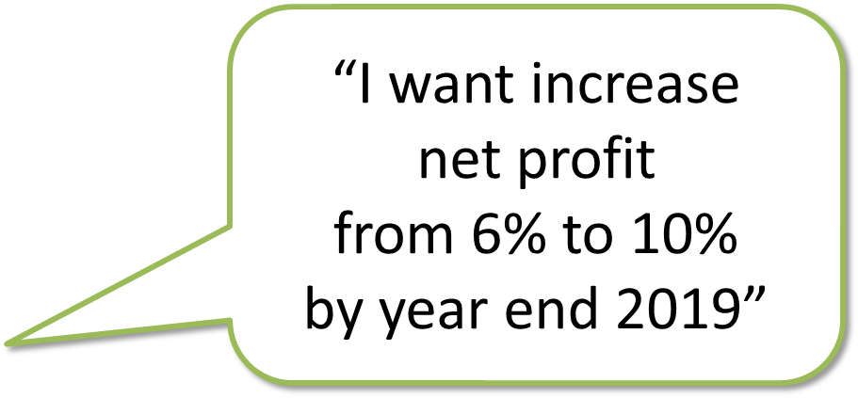
Figure out why net profit has been low
Frank
Marketing
Operations
Sales
Office
No one is held accountable
Our business mix favors unprofitable work
Andy
Zak
Roberto
Joan
Our marketing attracts too many price shoppers
Large paving jobs are often misestimated
Ops gets Incomplete job info from sales
No one is managing labor and material costs
No one is managing fixed costs

Slide 29
Define the tasks needed to reach the goal
Frank
Marketing
Operations
Sales
Office
Implement monthly goals, & weekly accountability meetings
Implement CRM to track results
Reduce work with GC’s
Andy
Zak
Roberto
Joan
Stop discounting and using Home Advisor to reduce price shoppers
Retrain on estimating large paving jobs
Change commission from sales to profit
Train Roberto how to manage Gross Profit
Goal = 2% Increase
Have Joan evaluate fixed costs quarterly.
Goal = 2% decrease
Institute weekly handoff meeting with Sales and Ops
Notes:
Letting everyone know their responsibility for every goal and priority needs to happen in your business too, to ensure alignment & success.
By clearly laying out ownership and responsibilities you increase alignment and coordination and dramatically increase that chances of success.

Slide 30
3. Follow through relentlessly!
Recalculating…
Notes:
Build

Slide 31
You play a critical role in making sure that the new changes take hold in your business.
Walk your talk!
Notes:
You play a critical role in making sure that the new changes take hold.
Everyone in your company will follow your lead.
Often the biggest hindrance to change that I see is you (and your team.)
If you want your people to make change you have to walk the talk

Slide 32
Track progress and adjust when you’re off track
What gets measured, gets done!
Notes:
Evaluate progress –
“What gets measured, gets done.”
To get great change results, you must be able to measure and track progress toward your goals.
enables you to hold the project owner accountable
Attention
One simple trick: Tune Up

Slide 33
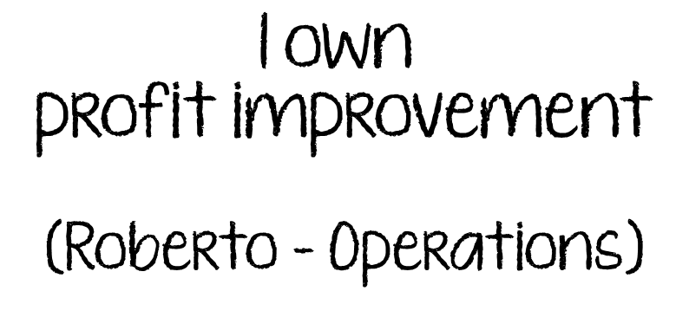
It also helps to assign an owner to drive the change
Notes:
Assign an owner –
Any goal or priority project that’s important to the success of your business needs to an owner who’s responsible for:
leading the charge and
for ensuring that you achieve the goal.
if there is no driving force who is accountable it usually doesn’t get accomplished.

Slide 34
The job isn’t done until you achieve the results you want!
Notes:
The job isn't done until you get the results you want.
Yet, I see owners and their teams declare, “Mission accomplished” because they implemented a new program
instead of ensuring that they got the desired results.
Example,

Slide 35
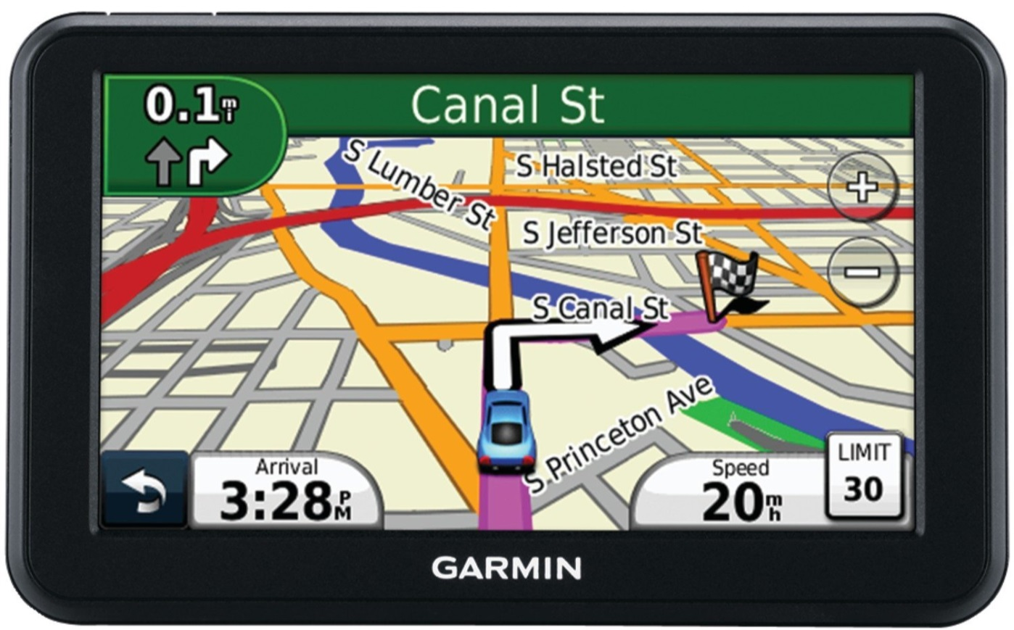
This GPS change model can add huge power to your change efforts
You have reached your destination!
Keeps your change efforts on course
Saves you time, money and heartache!
Creates Powerful Change!!!

Slide 36
The GPS change model works well for on large org changes too!
Frank
Operations
Sales
Office
Marketing
Frank
Frank
Roberto
Joan
Frank
Notes:
This GPS change model works well for large org changes too!
Explain org structure changes e.g. adding an ops manager
Talk about JVP’s
Metrics = measures of success
JVP Job purpose statements and detail
action plans = Step by Step Plans
Relentless follow through = training, mentoring and management process…
2:10

Slide 37
Minimize Resistance to Change
Horsepower Killer #2

Slide 38
Organizations don’t change… …Change happens person by person
Notes:
When you’re planning your change efforts, it’s important to consider that there is no such thing as organization change.
Organizations don’t change…
Change actually happens person by person.
The success of your change effort CLICK
Depends on your success CLICK
in getting each individual employee CLICK
to participate in the change CLICK
multiplied CLICK
by the number of people who are impacted. CLICK
CLICK

Slide 39
1. Identify and plan for resistance you might face from the employees impacted by the change
Notes:
Your change plan needs to pay attention to the resistance from the employees that are impacted by the change.
We all have a mental scale in our heads, and we weigh the costs against the benefits of change.
When the costs of change outweigh the benefits we resist.
So as you develop your change plan it’s important that you zero in on likely resistance points.
Understanding why people resist change will help you find better ways to make change stick.
the top 4 reasons why people resist.

Slide 40
Time and money are the most common reasons for resistance.
Notes:
The two of the most common costs of change, that tend to cause the most resistance, have to do with money and time.
We all have an amazing ability to quickly assess whether a change is going to impact us financially, or add work to our already full plate or both

Slide 41
Fear of failure will also keep your employees from embracing change…
Notes:
Change often requires your employees do new things or do familiar things in a different way.
This creates fear of failure and images of being laid off, missing out on a promotion, not getting a bonus….
So, the only way for them to try and survive is to resist change.
Eg. older employees are required to use new technology,
Fear of failure is difficult for employees to admit openly,

Slide 42
…so will loss of power or status
Frank
Operations
Sales
Office
Marketing
Frank
Frank
Roberto
Joan
Frank
Notes:
The last source of resistance that I want to highlight is loss of power and status structure.
Discuss
Summarize the list
So these are some of the key reasons why your employees may resist change,
Let’s try out an example

Slide 43
Why is everyone resisting profit improvement?
I’m so frustrated!
Why isn’t anybody following our cross selling plan?
UGH!
Frank
Marketing
Operations
Sales
Office
Implement monthly goals, & weekly accountability meetings
Implement CRM to track results
Reduce work with GC’s
Andy
Zak
Roberto
Joan
Stop discounting and using Home Advisor to reduce price shoppers
Retrain on estimating large paving jobs
Change commission from sales to profit
Train Roberto how to manage Gross Profit
Goal = 2% Increase
Have Joan evaluate fixed costs quarterly.
Goal = 2% decrease
Institute weekly handoff meeting with Sales and Ops
Notes:
Letting everyone know their responsibility for every goal and priority needs to happen in your business too, to ensure alignment & success.
By clearly laying out ownership and responsibilities you increase alignment and coordination and dramatically increase that chances of success.

Slide 44
2. Change employees’ mental scales by supporting them in making the change

Slide 45
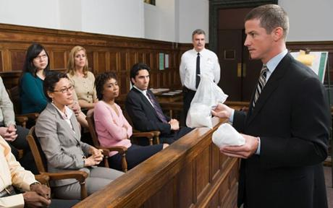
Make a compelling case for change
Notes:
To maximize your chances of success for almost every change, no matter how big or small, you need to create a compelling case for why the change is needed.
This step often gets skipped. Especially among owners who believe that “because I said so and I sign your paycheck” is the only compelling case that is needed.
If your employees don’t understand the need for change, you can expect resistance.
Remember that we’re working with that scale in your employees’ heads and they need to see that the benefits of making the change outweigh the costs.
So creating a compelling case for change is a critical step you need to take to begin to reduce resistance and motivate your employees to willingly participate.

Slide 46
Your compelling case needs to focus on 3 topics…
Why
do we need to change?
How will we get there?
What is the
Vision?
Notes:
To create a clear and convincing case for change, you need to focus on three areas
Why is this change necessary?
We often skip the why part. But research shows that when the logic behind why the change is necessary makes sense then your people are much more likely to come along willingly.
What are we trying to achieve? What is our vision of the future?
How is this change going to happen?
I want to drill down into these three points a little deeper because…
…For your case for change to be compelling case it should create a sense of urgency for you’re employees. To create that sense of urgency you need to highlight: CLICK
Dissatisfaction with how things are now;
There’s a famous saying that change happens when the pain of staying the same is greater than the pain of changing. They call that having a burning platform. So you need to highlight for them why the platform is burning and what will happen if we don’t change.
The second component CLICK is a Vision of what is possible; Make sure you include in the vision WIIFM.
If you don’t have a burning platform or a compelling vision then why would anyone willingly change? (Talk about my consultations if time)
The final step in creating a compelling case with a sense of urgency is to lay out some concrete 1st steps that you plan to take to move toward the vision. Your team wants to know how and when this is going to happen and it’s reassuring to know that you have a game plan
If your case has these three elements then you have a compelling case that will begin to reduce resistance.

Slide 47
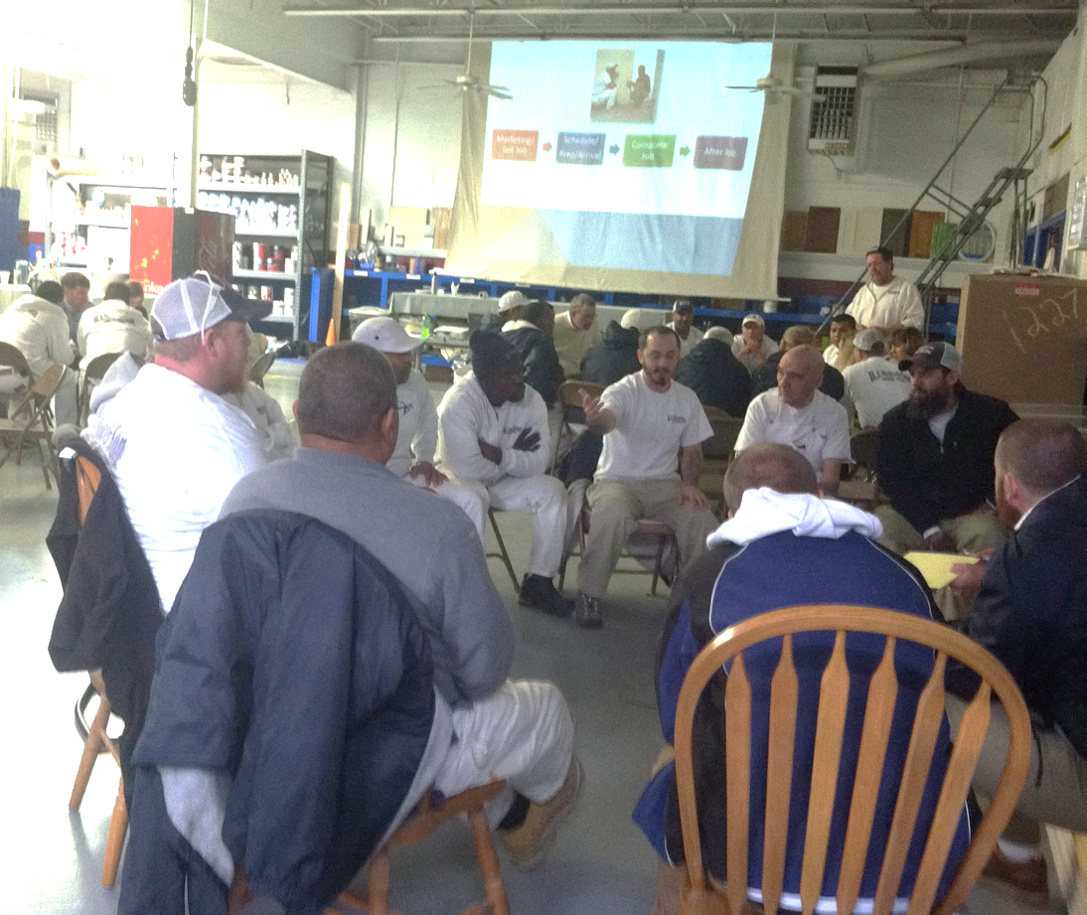
Get your team involved to get input and create buy-in
Notes:
A great way to help your employees bridge the gap is to is to get their input.
If you give them the chance to be part of the change process it gives them more control over what’s happening and there will less resistance and greater buy in as a result.
There are lots of ways to get input:
you can have group meetings to surface and resolve issues. That’s what we’re doing in the picture on the screen.
In the work that I do, we also do individual meetings to create individual development plans to help create custom support plans for the people affected by the change.
And getting input is not just for the beginning of the change process, but it is super valuable throughout the change process.
Josh
Mgt team input on Org Chart

Slide 48
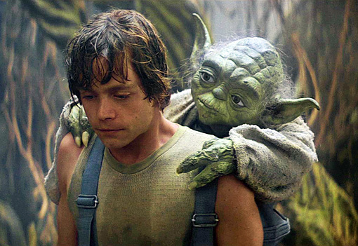
Mentor your team

Slide 49
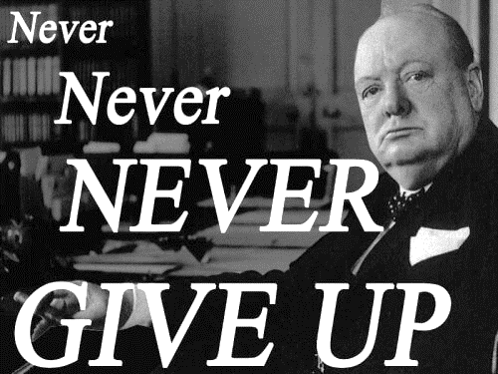
3. Persevere until the change sticks
Notes:
The final key to making change stick that I want to highlight is sheer willpower

Slide 50
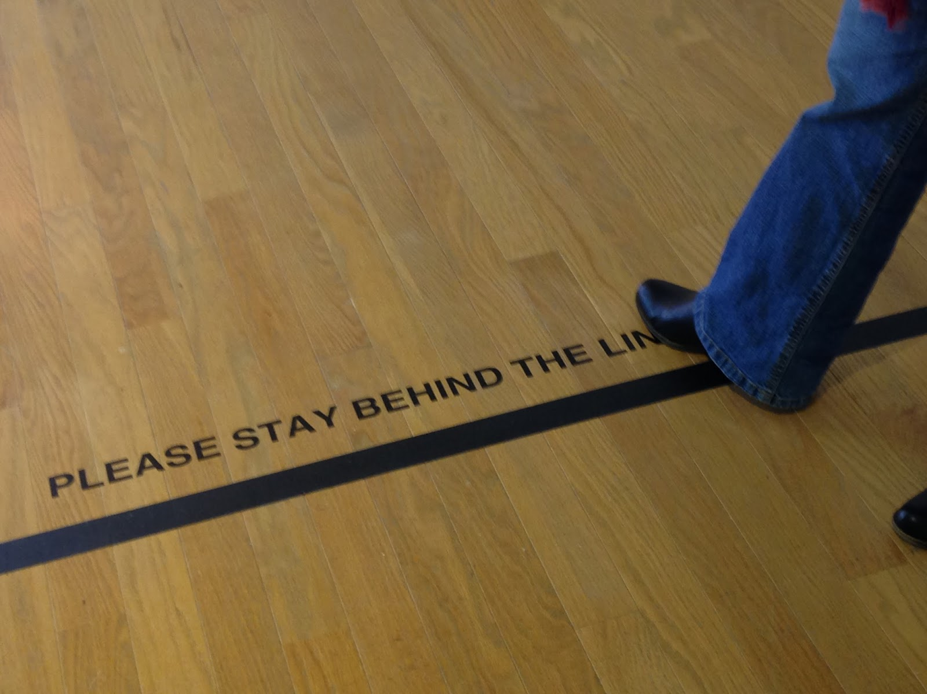
You will be tested…

Slide 51
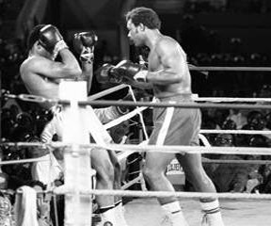
Some will give you the “rope-a-dope” and hope that you give up
Notes:
And your employees are on to you. So rather than expend a lot of anxiety and effort your next “flavor of the month program” they just wait you out, until the thrill is gone and you’re on to something new.
If you ever watched an old Muhammed Ali fight, he used to do something called the rope-a-dope. He’d back up to the ropes and cover his head with his arms and let his opponent throw punches until he tired himself out. That’s what we’re talking about here.
I know this first hand because I mastered the technique when I was working in corporate America.
Talk about Joe B. something 3 times
Wait for it to pass

Slide 52
Apply consistent gentle pressure
Notes:
All of your actions speak volumes about what you think is important and can have a huge impact on whether the change takes hold.

Slide 53
…reinforce the good…

Slide 54
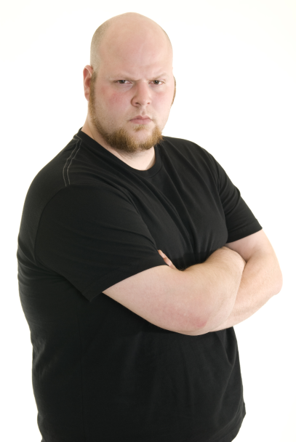
…don’t tolerate and allow those who won’t play ball
Notes:
There’s a saying that I like that says “You get what you tolerate”
Don’t tolerate and allow those who won’t play along…

Slide 55
Sometimes you’ll need to use not so gentle pressure too!

Slide 56
By persevering, resistance will diminish and the change will solidify!
Notes:
Like curing concrete to make sure that it hardens correctly into the form you want without cracks and other problems,
real change to your organization takes time, effort and consistent follow through to make sure that the changes that you implement solidify into your new way of doing business.
This process also takes consistent gentle pressure on your part since you will need to remold the structure that has already been established.
2:30

Slide 57
Notes:
I know that making changes in your business can be frustrating.

Slide 58
Setting clear goals
Following an action plan
Relentless follow trough
Finding resistance points
Supporting your team
Persevering
Notes:
But you’ll also reduce resistance and dramatically increase your success rate in making your change efforts stick.
Click click

Slide 59
You’ll make powerful changes!

Slide 60
And life will be good!

